Slide 1




Incoming webhooks with Azure Pipelines YAML
Igor Abade | @igorabade
CEO, CloudMotion
Microsoft Regional Director
2021 MVP Global Summit | DevOps MVP2MVP

Slide 2
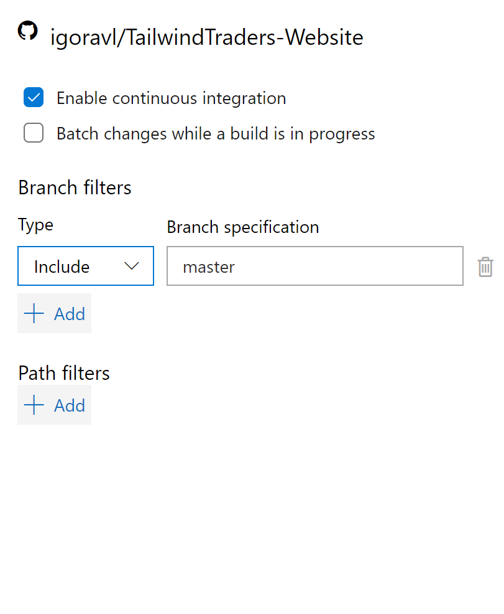
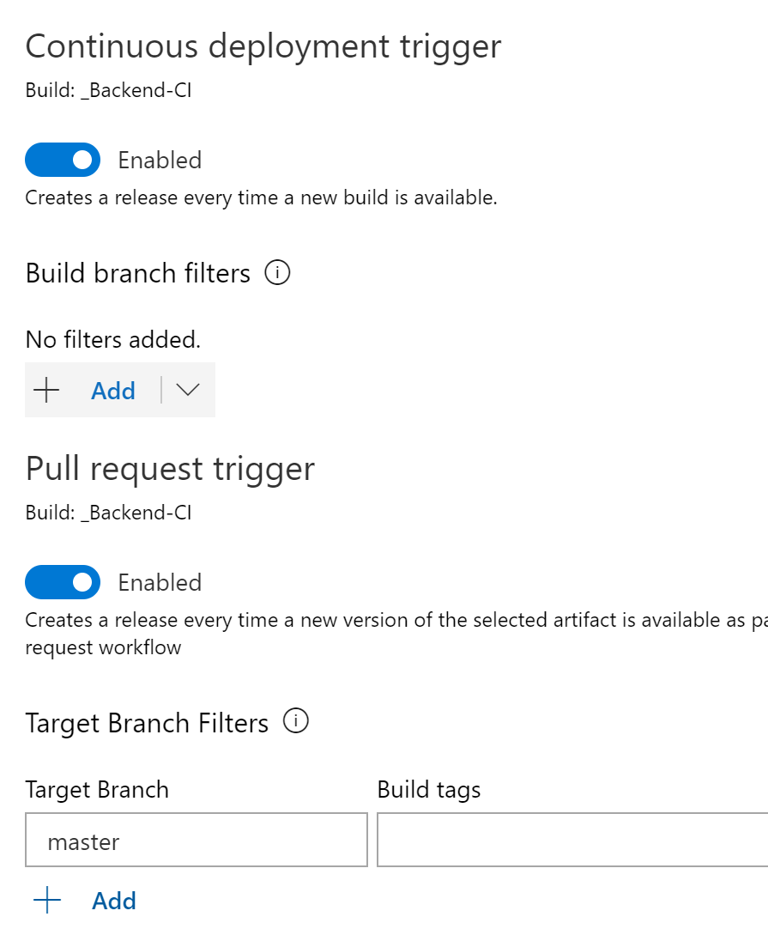
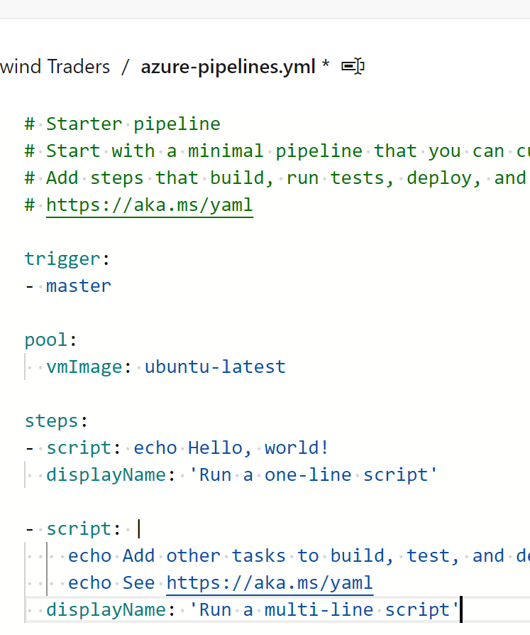
Azure Pipelines Triggers
Classic Build
Classic Releases
YAML Pipelines
Repo triggers
CI, PR
Scheduled triggers
Build completion triggers
Build artifacts
CI, PR
Code artifacts
Push
Build completion triggers
Build pipelines
CI, PR, Code, Comment...
Release pipelines
Pipelines, Scheduled...

Slide 3

A wish…
Anything can be a trigger
Pipeline as an automation engine
Just give me an HTTP(S) endpoint!

Slide 4
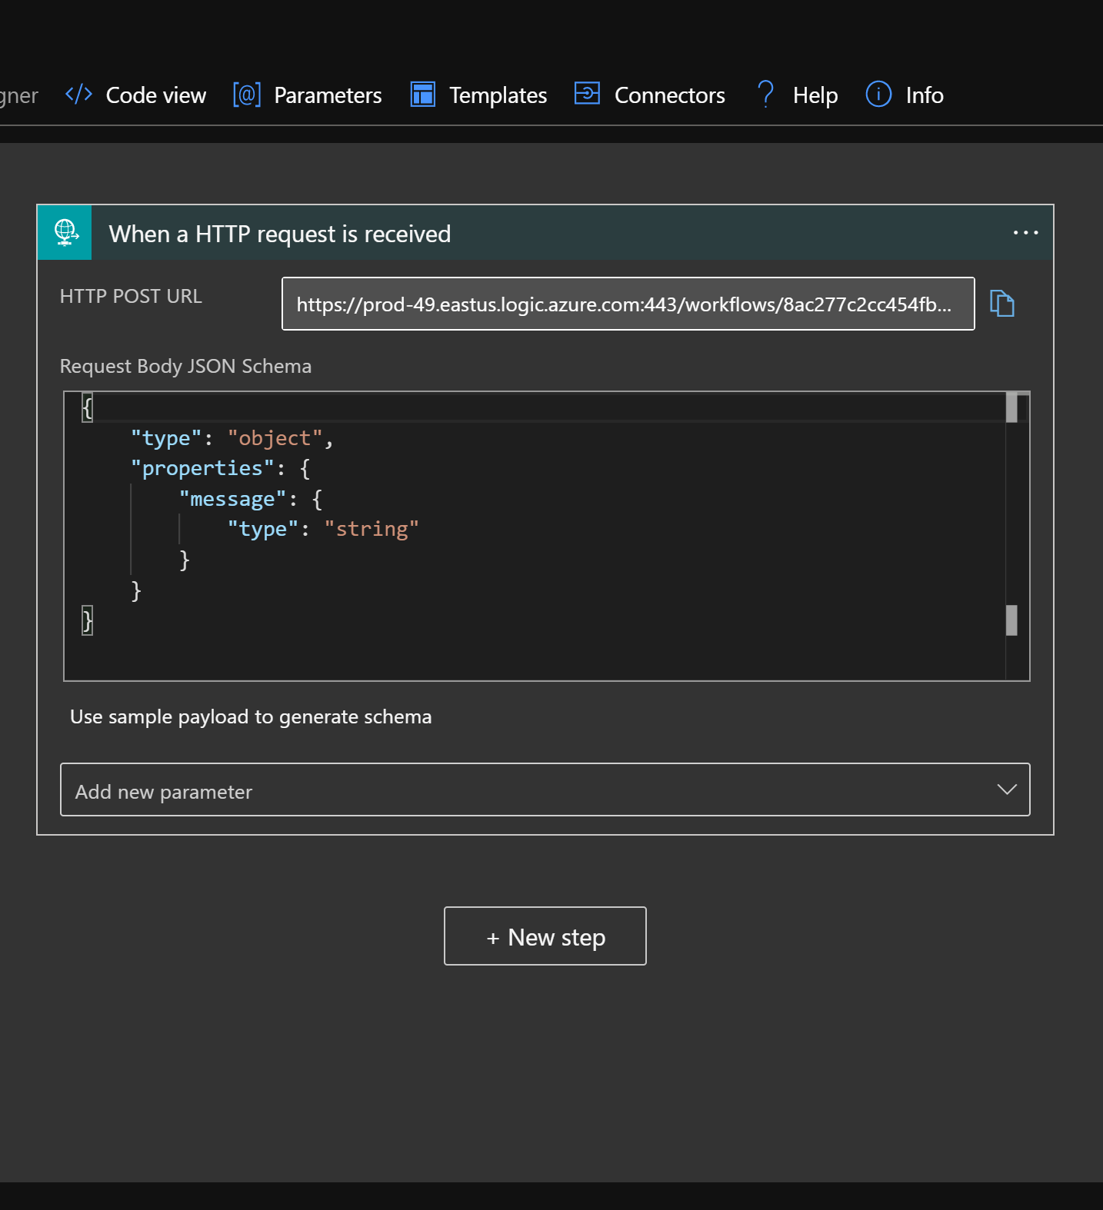
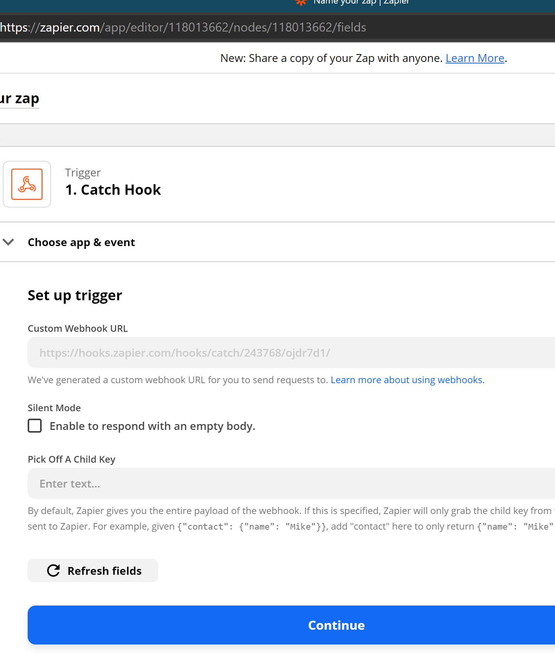
Others already do that
Logic Apps & PowerAutomate
IFTTT, Zapier etc.
GitHub Actions
on: repository_dispatch:
types: [webhook_type]

Slide 5
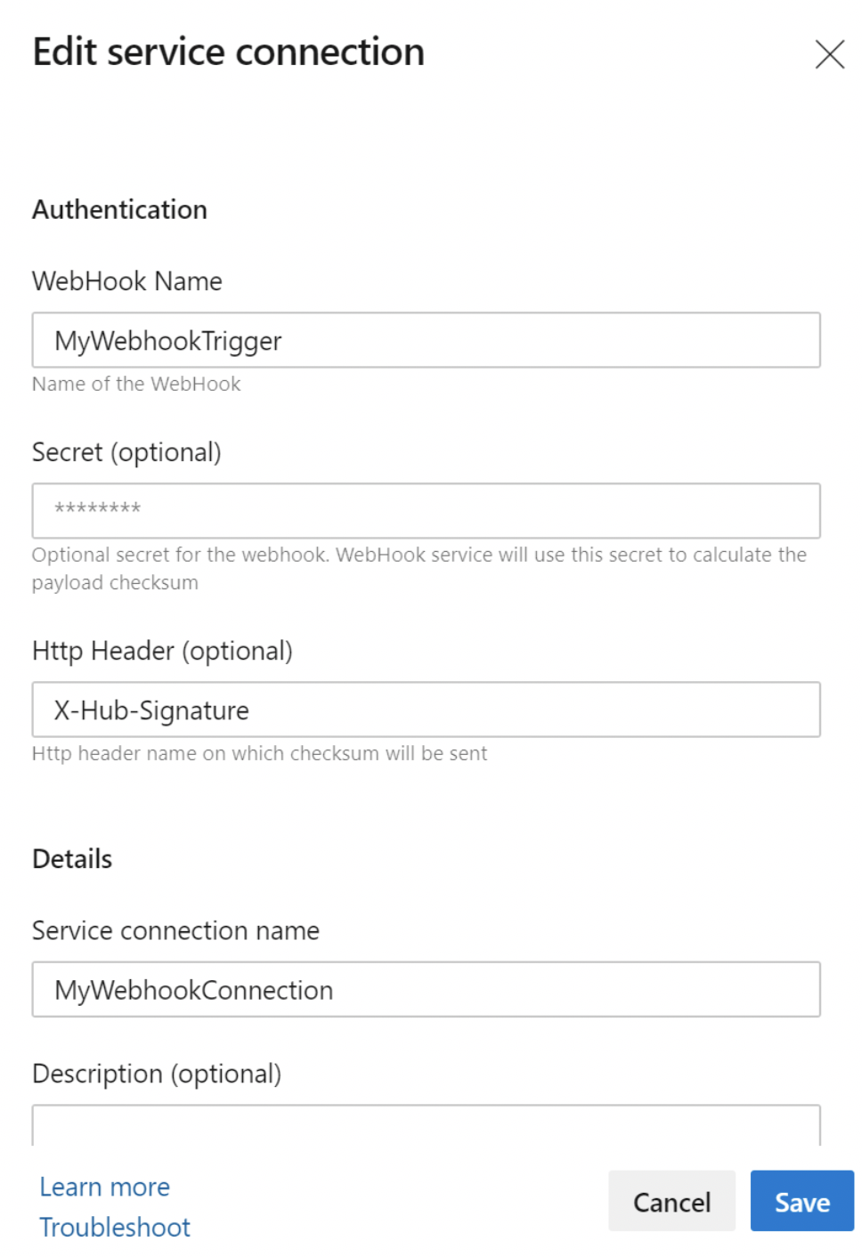
Meet “Azure Pipelines Incoming Webhooks!”
Not so new, actually
Released in Sprint 172 (Jul 2020)
HTTP Endpoint to trigger pipelines
Restricted to YAML
Implemented as a specialized Service Connection

Slide 6
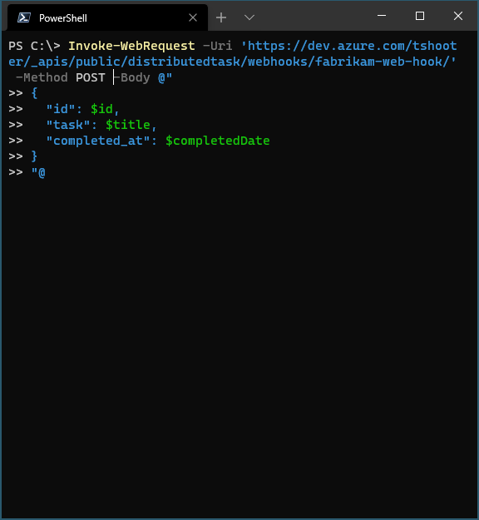
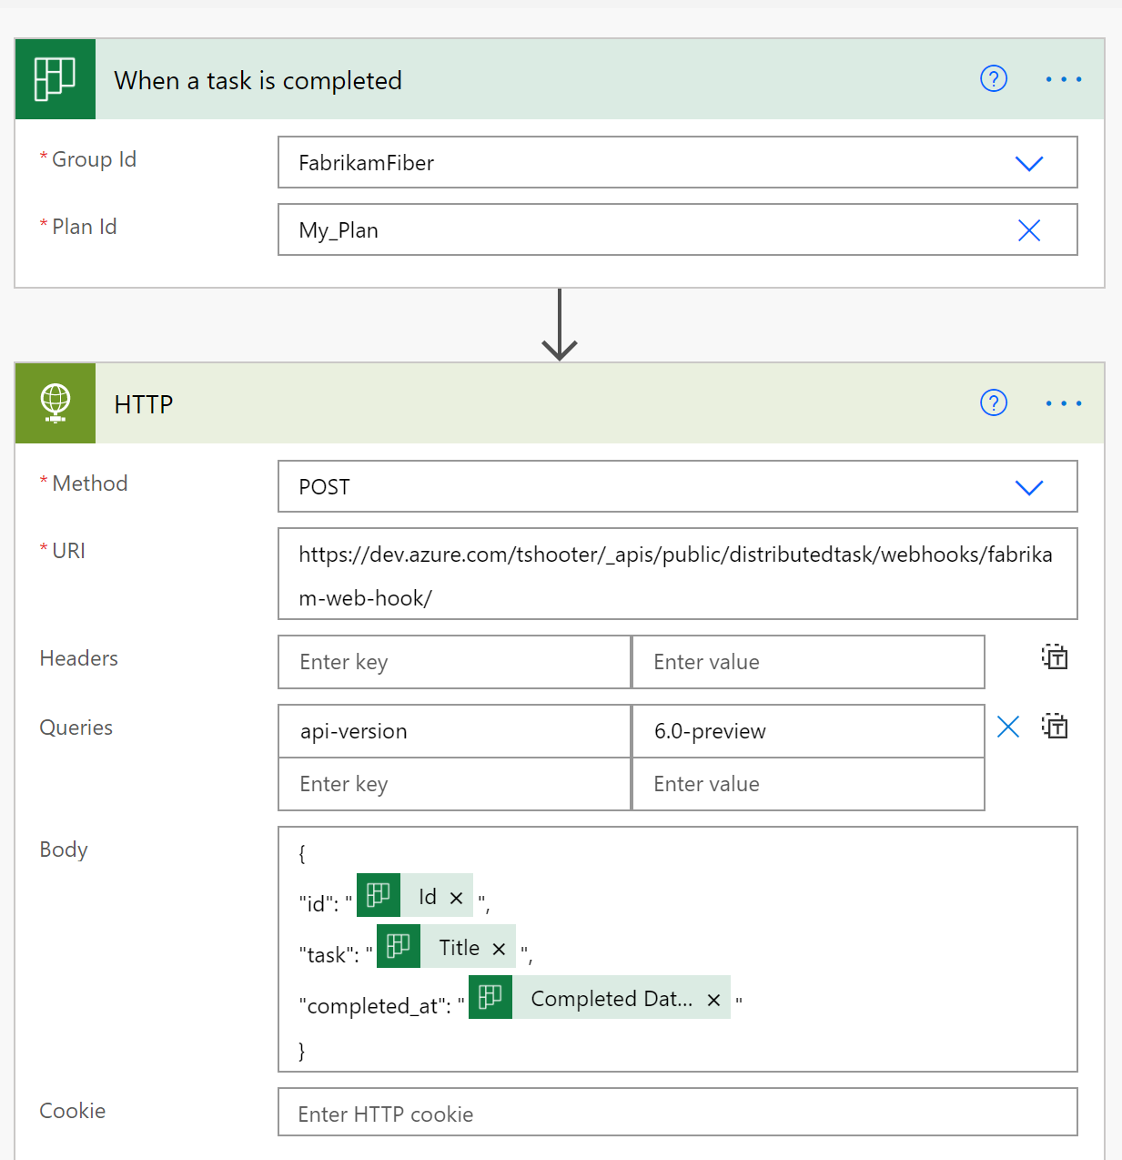
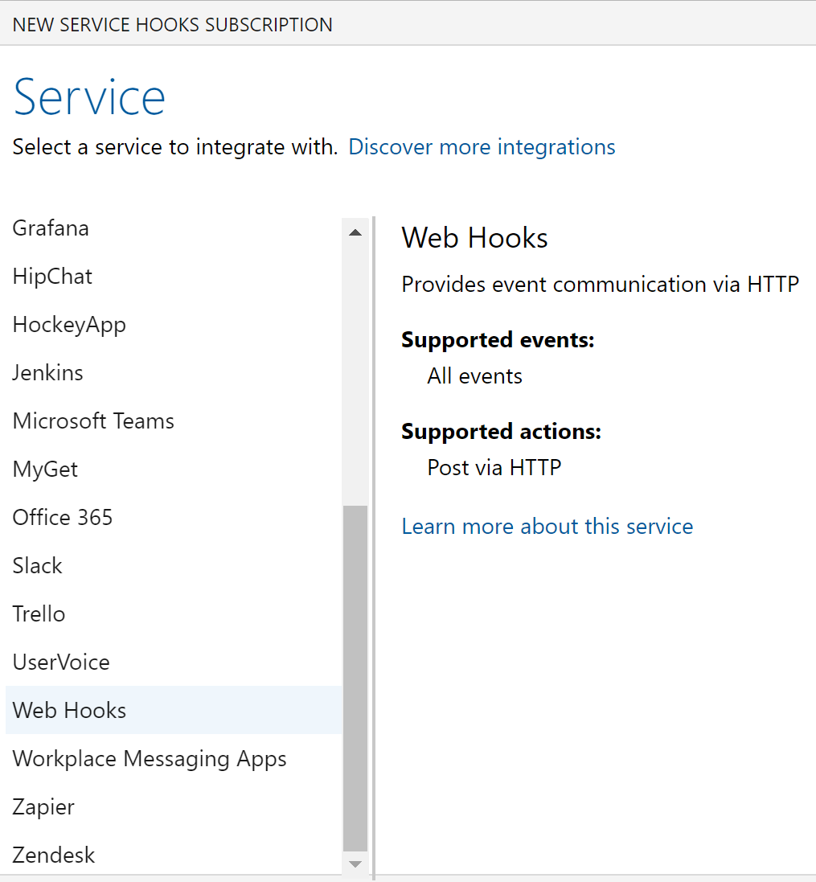
Things that can trigger a pipeline
Azure DevOps Events
E.g., “Build on work item updated”
Third-party webhooks
Jira, Trello, ServiceNow…
Custom code
Just send your own JSON payload to the designated endpoint

Slide 7
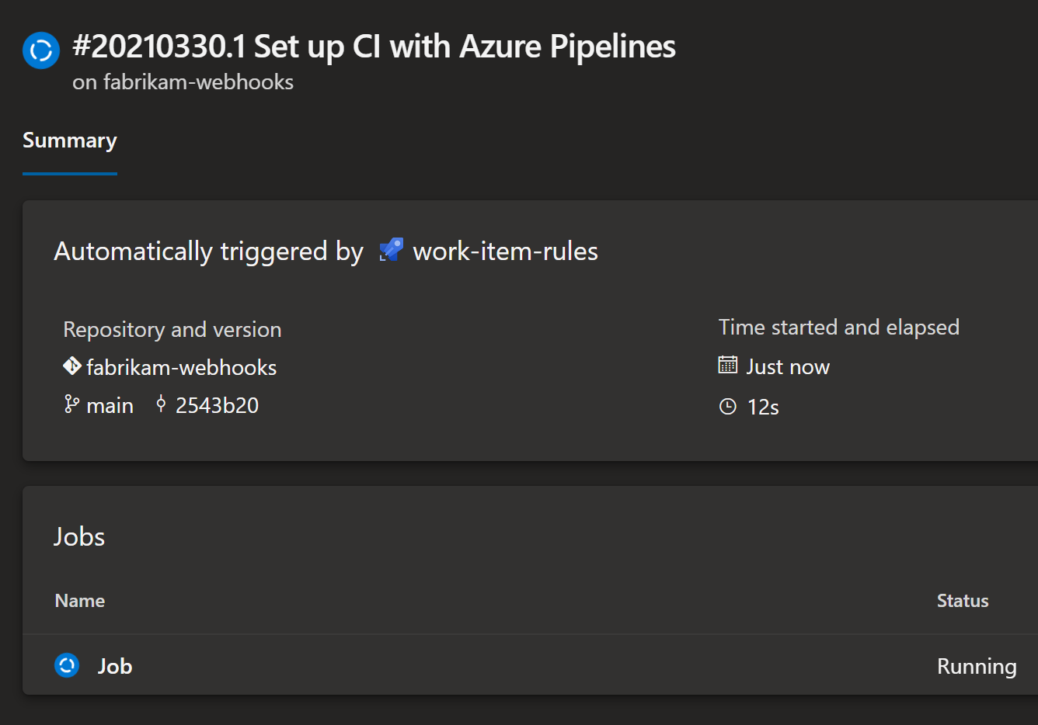
But… Why?
Pipelines can react to Azure DevOps events
“TfsAggregator-like” solutions
Pipelines can react to external services
Leverage YAML pipelines as an open automation workflow, beyond code
Pipelines as an “integration engine”
Can be used in place of Logic Apps, Functions, PowerAutomate
Keep using the tool you’re most familiar with
Powerful extensibility

Slide 8
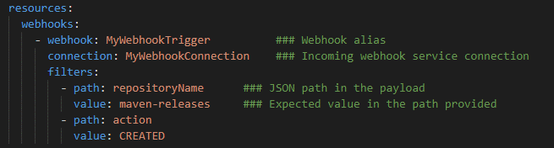
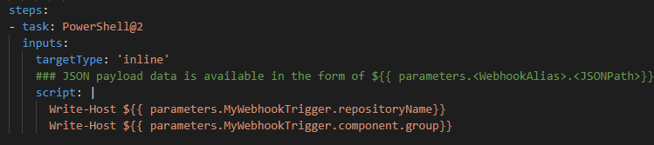
What it looks like
https://dev.azure.com/<org>/_apis/public/distributedtask/webhooks/<svc-trig>/?api-version=6.0-preview

Slide 9
Watch out!
https://dev.azure.com/<org>/_apis/public/distributedtask/webhooks/<svc-trig>/?api-version=6.0-preview

Slide 10

Demo

Slide 11
Calling secure endpoints
Param
(
# URL to the Azure DevOps incoming webhook endpoint. Expected format is https://dev.azure.com/<org>/_apis/public/distributedtask/webhooks/<svc-trig>/?api-version=6.0-preview.
[uri]
$Url,
# Shared secret used to sign the JSON payload. Must be the same value supplied during the creation of the Incoming Webhook service connection
[string]
$Secret,
# HTTP header name to send the hash signature. When omitted, defaults to "X-Hub-Signature"
[string]
$HeaderName = 'X-Hub-Signature',
# JSON payload to send to the Azure DevOps web hook
[string]
$Body
)
$hmacSha = New-Object System.Security.Cryptography.HMACSHA1 -Property @{
Key = [Text.Encoding]::ASCII.GetBytes($secret)
}
$hashBytes = $hmacSha.ComputeHash([Text.Encoding]::UTF8.GetBytes($body))
$signature = ''
$hashBytes | ForEach-Object { $signature += $_.ToString('x2')}
$headers = @{
$headerName = "sha1=$signature"
}
Invoke-WebRequest -Uri $Url -Body $Body -Method Post -ContentType 'application/json' -Headers $headers

Slide 12


